Slide 1
Advanced Database Management
CMPS 1024

Slide 2
Objective
Introduction to Database
Relational Database
Primary Key
Normalization

Slide 3

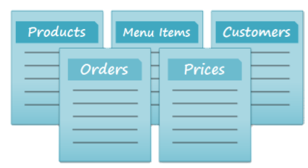
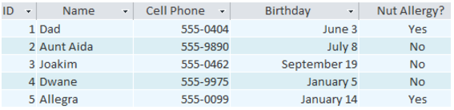
Introduction to Database
What is a database?
Collection of data stored in a computer system.
Collection of list (eg. Inventory list)
Benefits of using a database
Enter (edit, aggregate data)
Access
Analyse
Eg. If you were a baker you would have a list of people
and cookies to keep track of orders
However in access it is more complex than a paper list
Because it stores the list of data in TABLES, that can include
more detailed information.
But a professional Baker would have many more lists
Read more

Slide 4
Relational Database
Access is Relational Database Management System (RDBMS)
Relational Database organize data in Tables to have relational properties.
Tables are made up of rows and columns.
Each row is a record in Access
Each column is a field or Attributes
Database is similar to spreadsheets
What makes RDBMS more powerful are the relationships that can be created among tables to enable it to store a large amount of data as it relates to a record.

Slide 5
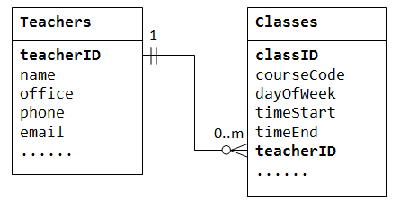
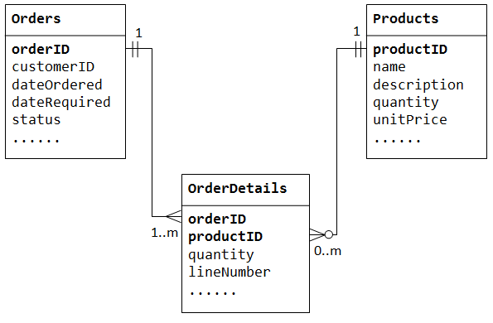
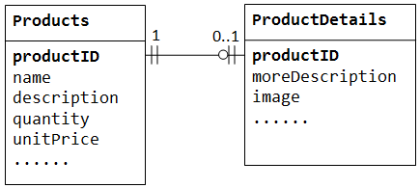
Types of Relationships
One-to-many
Many-to-many
One-to-one

Slide 6
Relational Database Continued
Step 1
Gather requirements (forms, queries, reports)
Define objective and scope
Step 2
Gather Data and categorize into Tables
Specify Primary Keys-unique identifier
Step 3
Create Relationships among Tables
One-to-Many, many-to-many, one-to-one
Step 4
Refine and normalize the Design
Well designed database
Reduce data redundancy (duplicate data)
Maintain data integrity
Is Dynamic by design

Slide 7
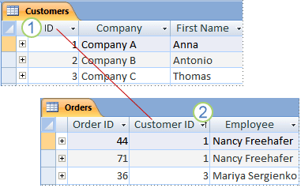
Primary Key
Tables cannot contain duplicated Primary Keys/Rows
Each table must have a unique PK that uniquely identifies each record
Eg. CustomerID can be a PK for Customer table, ProductID can be the PK for Product table
PK shall never be NULL
PK Values shall not change/Edit
PK can be set to auto-increment
A primary key from Table 1 included as a field in Table 2 is called a Foreign Key in Table 2

Slide 8

What makes Good Primary Key?
Unique
Never Null
Constant-
(rarely change)
What is a POOR PK ?
SSN
Phone #
Name
Access can generate AutoNumber Field to use as a PK

Slide 9

Types of Primary Key
To Set Primary Key
Candidate Key: potential PK
Composite Key: uses more than one field.
Primary Key: A unique identification to each row in a table
Foreign Key: Attribute in one base table that points to the PK of another table.
Navigation Pane, right click the table that you want to set as the primary key.
From the short cut menu, go to Design view
Select the field or fields that you choose to be the primary key
To add another field after selecting one as PK, hold down CTRL and proceed to select the other field
Go to Design Tab>Tools Command> Primary Key
A key icon will appear on the left of the field/fields

Slide 10


To Remove Primary Key
Removing PK removes the index that was created for the PK
First ensure that the PK is not being used in any other Table (relationship)
Delete the Table relationship
Close all Tables
Database Tools> Relationship> Relationships
If you are not seeing the Tables in the Design Tab select Show Table
Select the Table in the Dialog Box and choose Add, and Close
Click the Table relationship line to be deleted and press the Delete Key
Right click on the table you wish to remove the PK and select the Design view
Select the row(s) of the current PK and go to Design Tab> Tools Group > PK

Slide 11

Normalization
Purpose of the table
Identifying the organization’s salespeople
Listing the sales offices and phone numbers
Associating a salesperson with an sales office
Showing each salesperson’s customers
A Table should only serve one purpose and not many…
Avoid data duplication and

Slide 12
Normalization
Check to ensure that your database is structurally correct
First Normal Form (1NF): every cell contains a single value and not a list of values (atomic)
Minimize duplicity
Second Normal Form (2NF): every non-key column depends fully on a primary key even if it is a composite key.
Third Normal Form (3NF): If the non-key columns are depended only on the primary key and nothing else
Higher Normal Form goes to 4NF and 5NF, when normalization rules are broken

Slide 13
Add a Slide Title - 5

